Slide 1
IT TICKET ANALYSIS
A Data Analytics Project
BY ASHUTOSH GIRI

Slide 2
PROBLEM STATEMENT
To analyze the IT support ticket management system to understand the performance of IT agents, the efficiency of ticket resolution, and the satisfaction levels of employees.
The analysis aims to identify high and low performers among IT agents, assess the overall effectiveness of the team, and pinpoint areas for improvement in the ticket resolution process.
The ultimate goal is to make informed staffing decisions, including hiring, firing and training, to enhance overall service quality and team performance.

Slide 3
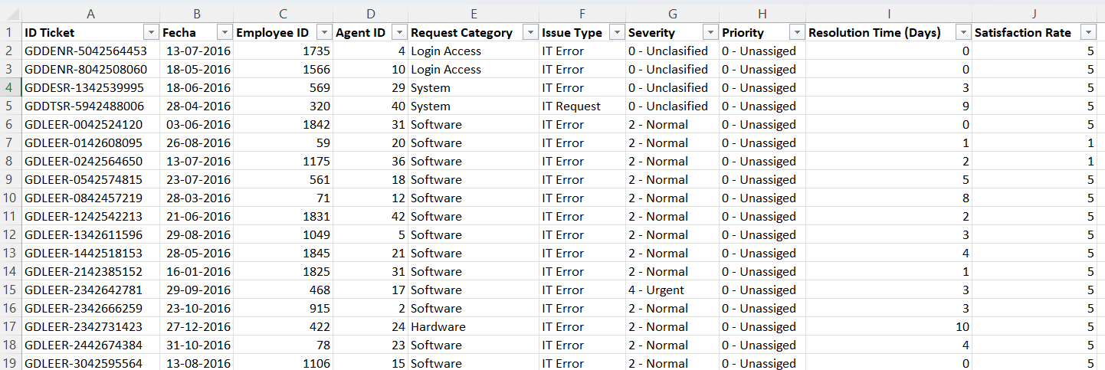
Data description
The dataset contains multiple columns including Ticket ID, Date, Agent ID, Employee ID, Agent Name, Satisfaction Rate, Resolution Time, Age of Employee, Request Category, Issue Type, Severity, Priority of Issue etc.

Slide 4
workflow
Data Collection
Data Cleaning
Data Analysis
Data Visualization
Insights & Recommendations

Slide 5
MONTHLY TICKET VOLUME TREND
Insight:
Ticket volume increases steadily throughout the year peaking towards mid to end of year.
Implication:
IT teams should prepare for higher workloads in the second half of the year by increasing staffing or resources in advance.

Slide 6
Average Resolution Time by Request Category (Quarter-wise)
Hardware takes the longest to resolve — around 7.5 to 7.7 days across all quarters, meaning hardware issues are consistently the most time-consuming.
Login Access is resolved super quickly — under half a day (0.31 days), so the team handles access issues almost instantly.
Software issues take a moderate 5 to 5.3 days, sitting in the middle — not too fast, not too slow.
System issues are close to Hardware at around 6.5 to 6.6 days, also taking significant time to fix.

Slide 7
Age Group by Satisfaction Rate
Senior (41-50) age group is the most satisfied with a score of 4.22 — older users seem happiest with the support they receive.
Young (20-30) comes in second at 4.14 — still quite satisfied, just slightly behind seniors.
Mid (31-40) is the least satisfied at 4.03 — though still a decent score, this group feels the support could be better.

Slide 8
TICKETS BASED ON SATISFACTION RATE
Satisfaction rating 5 has the highest number of tickets at around 50,000 indicating that the majority of customers are highly satisfied with the IT support service.
Ratings 1 and 2 have very low counts showing that poor service experiences are rare and the overall quality of support is consistently high.

Slide 9
TICKETS BY CATEGORY
System has the largest share with 39,002 tickets followed by Login Access with 29,193 indicating that system and access related issues are the most frequent problems faced by employees.
Software has 19,570 tickets while Hardware has the lowest at 9,733 suggesting that physical equipment issues are minimal but software and system reliability needs immediate attention and investment.

Slide 10
TICKETS BY SEVERITY
Normal severity has the highest count indicating most IT issues are moderate and do not require urgent intervention.
Urgent and Major tickets are the least in number showing critical issues are rare but must be prioritized immediately.

Slide 11
SATISFACTION RATE BY PRIORITY
Satisfaction rate is fairly consistent across all priority levels ranging between 4.07 and 4.14 showing the team handles all priorities effectively.
Unassigned tickets have the lowest satisfaction at 4.07 indicating that tickets without clear priority assignment are not handled as efficiently.

Slide 12
SEVERITY VS AVERAGE RESOLUTION TIME
Urgent severity tickets take the longest to resolve indicating that critical issues require more time and specialized skills to fix.
Normal and Minor severity tickets are resolved faster showing that standard procedures work well for routine issues but need improvement for complex ones.

Slide 13
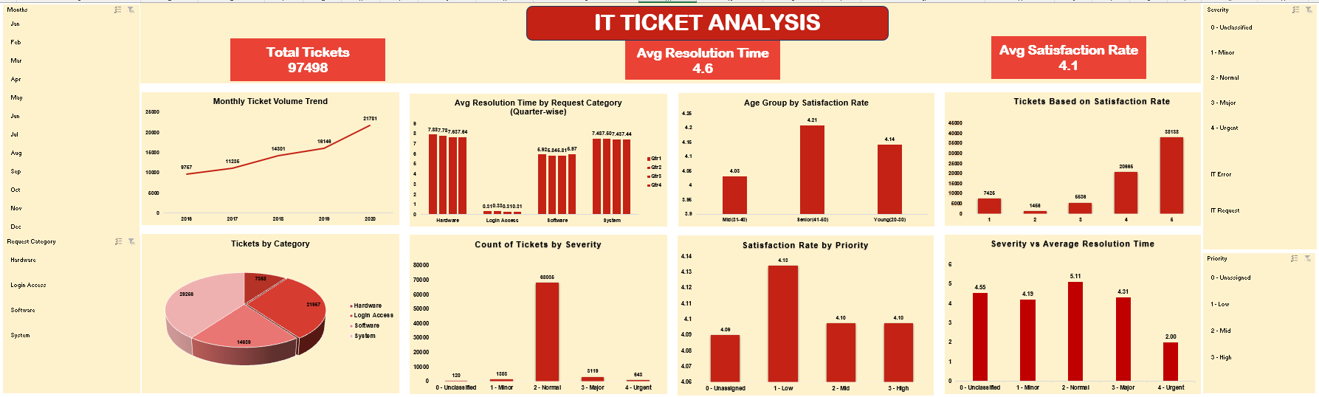
dashboard

Slide 14
conclusion
The IT support team successfully handled nearly 97,498 tickets with a solid satisfaction score of 4.1 out of 5, showing overall good performance.
Ticket volume has been steadily increasing year over year, with a sharp jump in 2019–2020, indicating growing demand on the support team.
Hardware and System issues take the longest to resolve at 6–8 days while Login Access is fixed in under a day, showing a big gap based on issue complexity.
Resolution times are consistent across all four quarters, meaning performance is stable but there's also no visible improvement happening over time.
Senior employees (41–50) are the happiest with support at 4.22, while the Mid age group (31–40) is the least satisfied at 4.03 and needs more focused attention.
The majority of tickets fall under Normal to Major severity, with very few urgent ones, suggesting the workload is manageable but complex issues still exist.
As priority level increases, satisfaction tends to drop, meaning the team struggles more with high-pressure and urgent tickets compared to routine ones.
Over all the team is performing well, but scaling resources, reducing hardware resolution time, and improving high-priority ticket handling will be critical for future growth..

Slide 15
recommendations
Since ticket volume is rising sharply, the team should consider hiring more support staff or automating routine requests to handle future load.
Hardware and System issues take 6–8 days to resolve, so dedicated specialists or faster escalation processes should be set up for these categories.
Login Access is already fast under a day, so that process can be used as a model and applied to improve other slower categories.
The Mid age group (31–40) has the lowest satisfaction, so their specific pain points should be studied and addressed through better communication or faster resolution.
Since high priority tickets have lower satisfaction, a separate fast-track team or process should be created specifically for urgent and critical issues.
Resolution time is stable but not improving across quarters, so the team needs to set clear improvement targets and track progress every quarter.
The Normal to Major severity tickets are the highest in volume, so more resources and training should be focused on handling these efficiently.

Slide 16
Thank you

